Slide 1

Sakai: Ten Years of Open Source Leadership in Higher Education
Dr. Charles Severance
University of Michigan School of Information
www.dr-chuck.com
LAMP Consortium – 28-Jul-2014

Slide 2
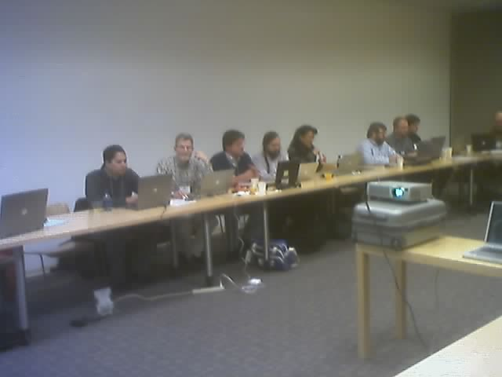
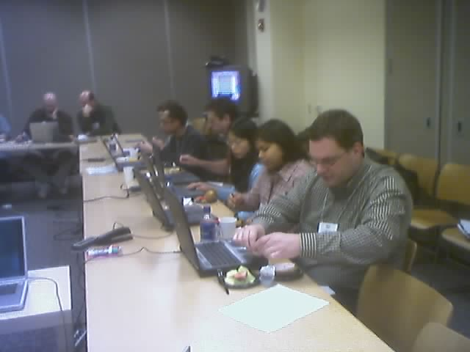
TenYears Ago - February 19, 2004 - Sakai All Hands Meeting @ Stanford

Slide 3
At 02:28 PM 3/2/2004 -0500, Chris Etesse wrote:
Chuck, Jeff and Babi,
It was my pleasure talking to you both during my travels recently - Chuck in person in Edinburgh and Jeff & Babi via phone from Europe. As promised, I wanted to pass on a link to a white paper we just released on Blackboard & Standards as well as restate my invitation to host a meeting at Blackboard with Chuck to discuss how we can interoperate going forward. Finally, the second link is to the Blackboard SDK's for our various products - I thought it might be of some interest. I look forward to working closer with you each.
Warmest regards,
Christopher Etesse
Senior Director of Technology
Blackboard Inc.

Slide 4
DRAFT Software Portability Workgroup Prospectus DRAFT
The current trend in web-based systems for eLearning has been moving steadily towards increasing componentization and modularity. This trend is driven to a large extent by the desire for systems deployers to easily enhance system functionality to more quickly and effectively support the maturing demands of LMS users. Three notable examples are referenced here:
Blackboard Building Blocks
Sakai’s Tool Portability Profile
WebCT PowerLinks SDK
Joseph Hardin
University of Michigan
September 3, 2004

Slide 5
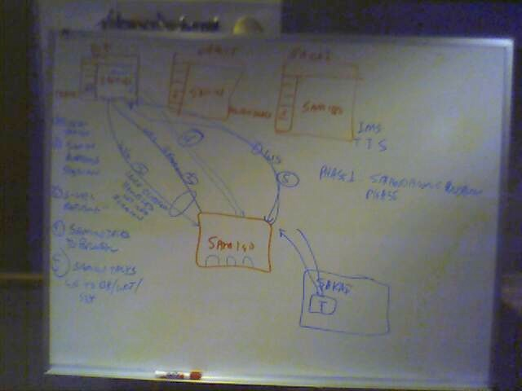
Brainstorming at IMS Meeting in Denver 2004-10-19

Slide 6
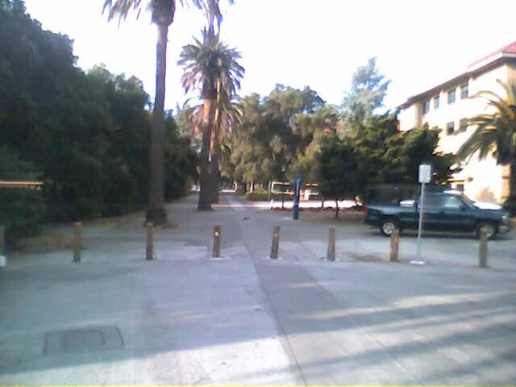
Publisher Meeting @ Stanford
Colleagues:
It looks like we have about 25 individuals (give or take) attending the SCP/SCA/Board meeting on 4/27/2005 from 1-5 pm. This includes the Board (9). See list below. At this point, I'd rather not invite any more people.
Textbook Publishers Invited/Attending...............................................
Allen Noren, O'Reilly & Associates -- ATTENDING
Ray Henderson, Pearson Education -- ATTENDING
Schoen, Steve, Thomson Higher Education -- ATTENDING
David Serbun, Houghton Mifflin Company -- ATTENDING
Jonathan Stowe, John Wiley & Sons, Inc. -- ATTENDING
Glenn Kammen, Intelecom -- ATTENDING
Vivian 'Vivie' Sinou
Dean, Distance & Mediated Learning
Foothill College

Slide 7
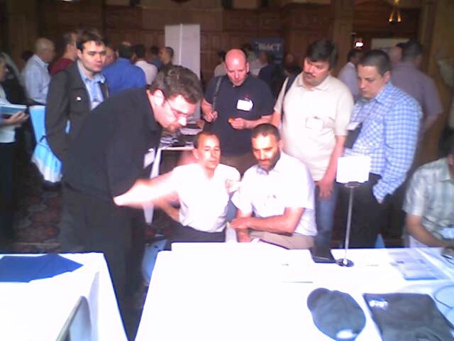
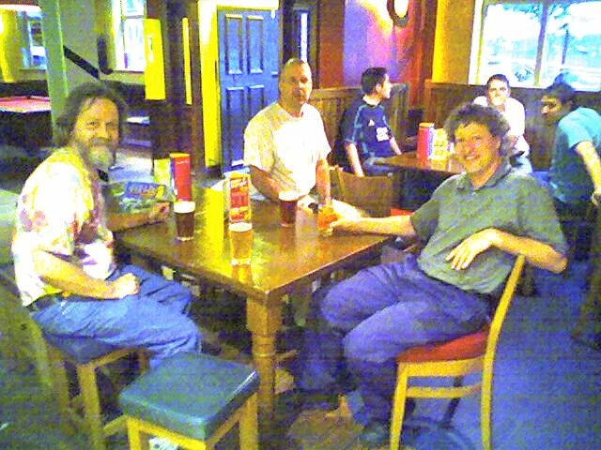
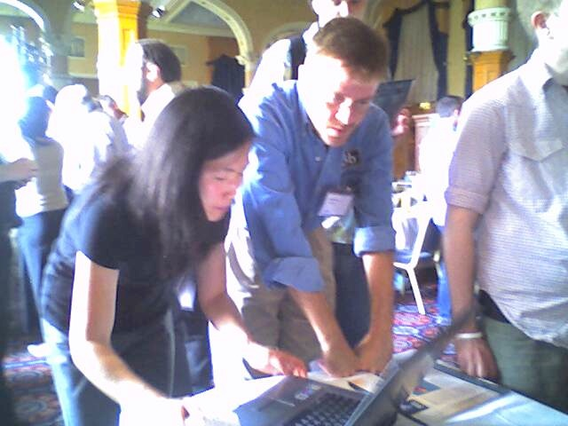
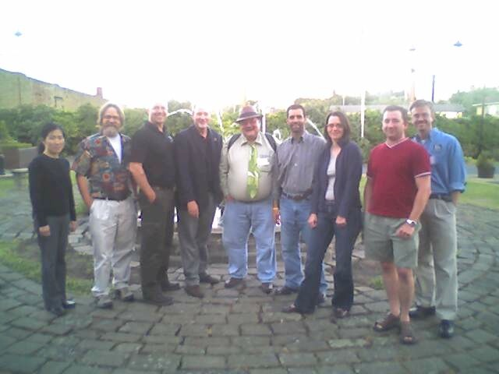
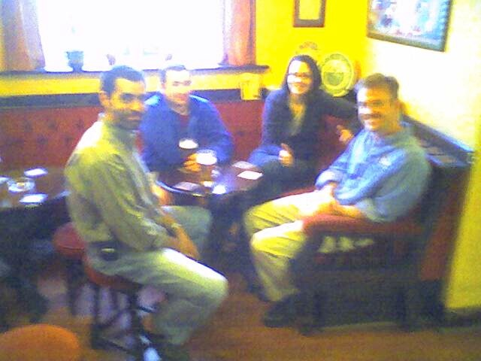
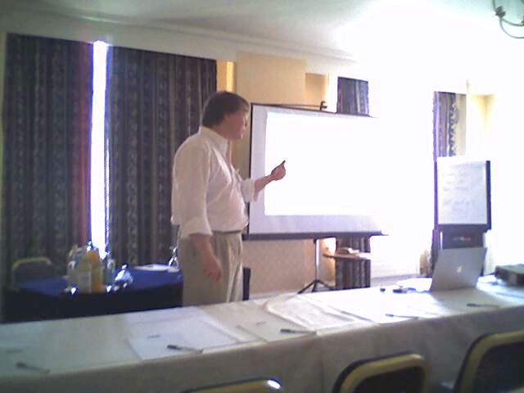
June 21, 2005,
IMS Alt-I-Lab Sheffield, UK

Slide 8
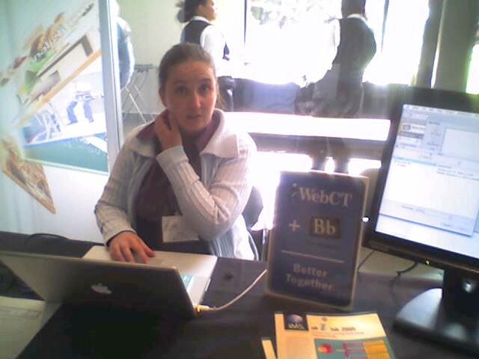
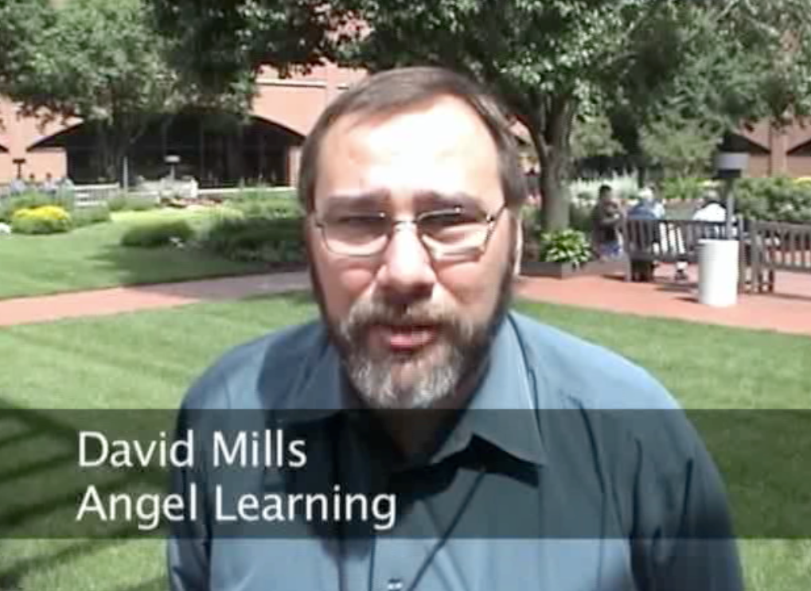
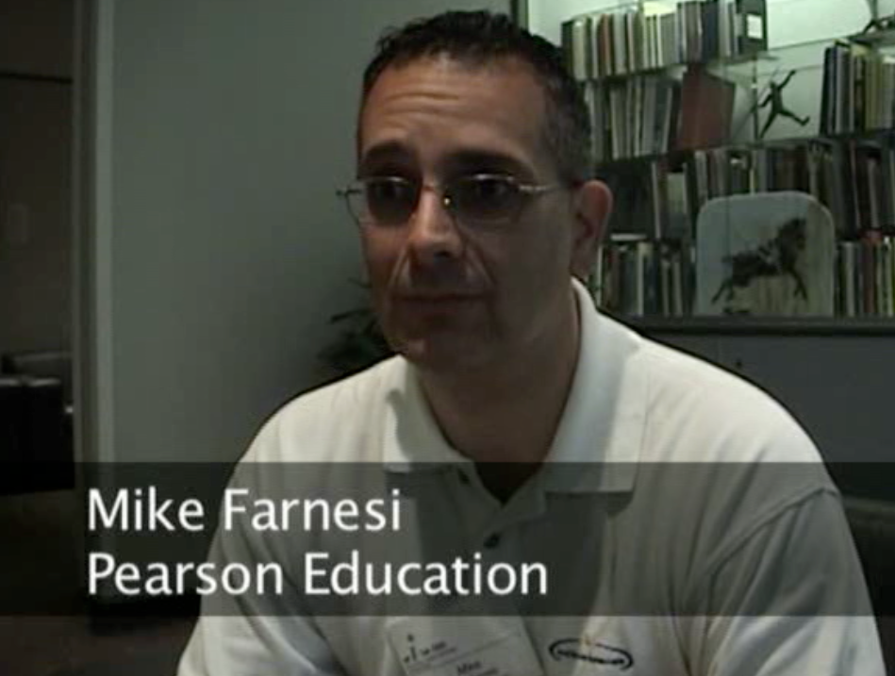
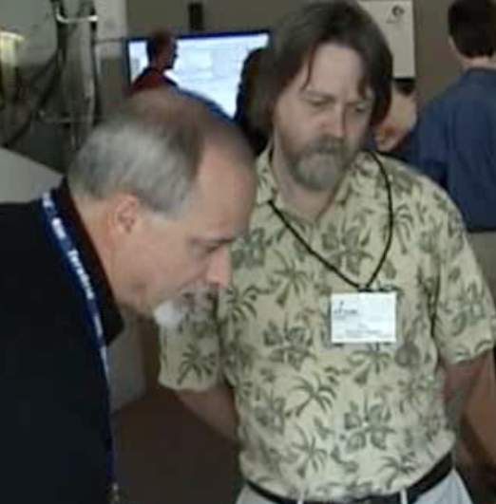
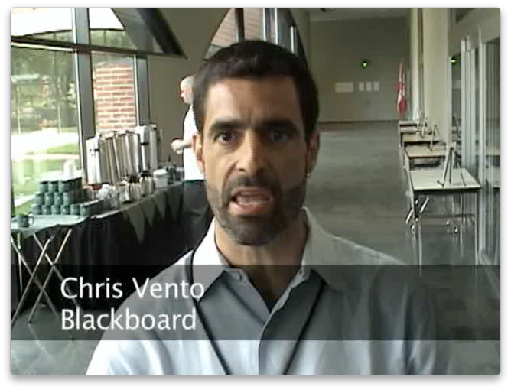
June 21, 2006
IMS Alt-I-Lab
Indianapolis, IN

Slide 9
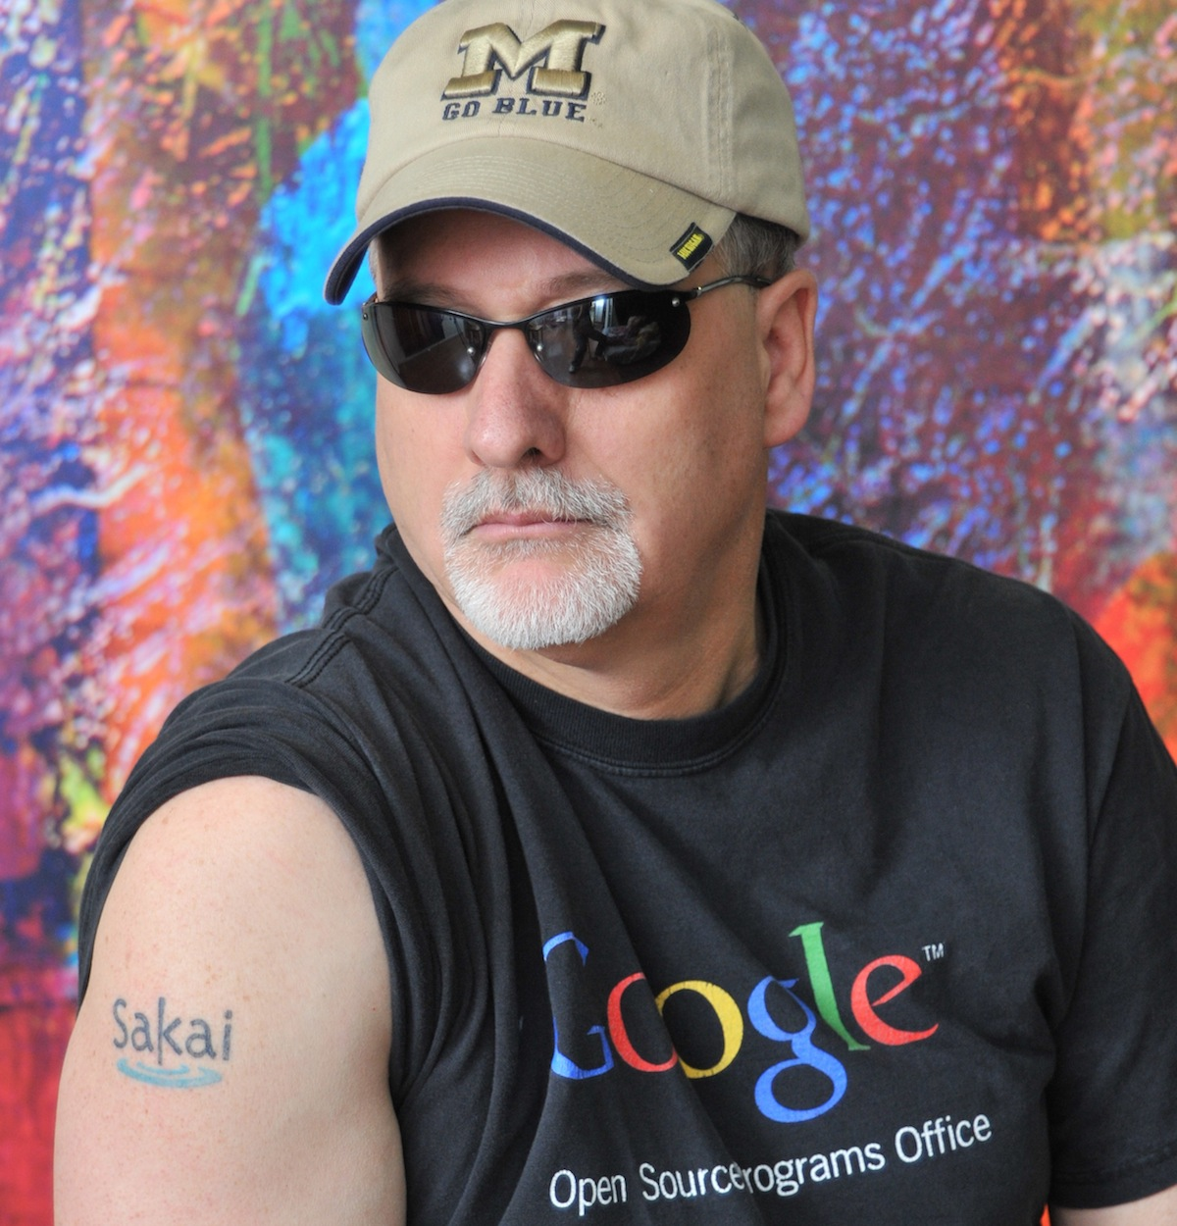

February 2007

Slide 10
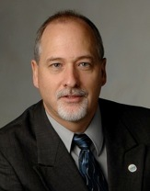

Tools
Interoperability
Commercial
Common
Cartridge
Publishers
LMS
Open Source
Standards
2008
www.imsglobal.org

Slide 11
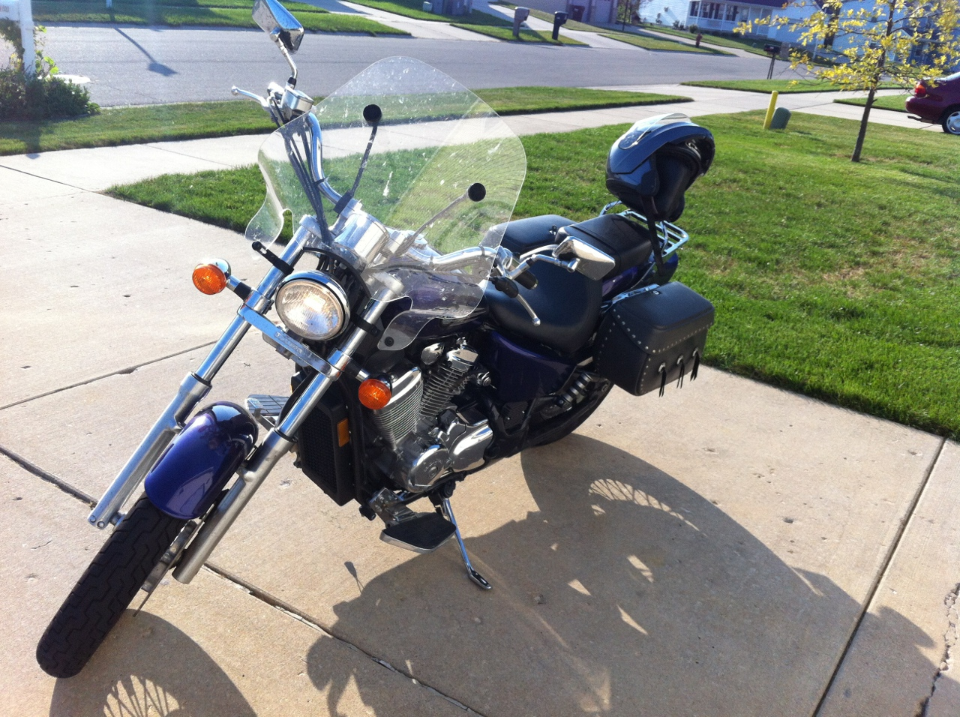
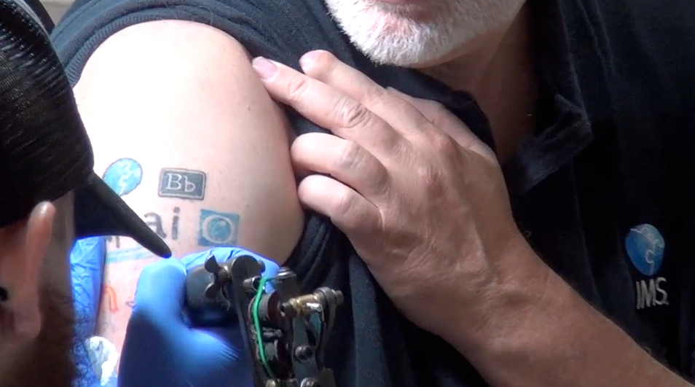
July 2012
http://www.youtube.com/watch?v=VY-Ogkc7Mnw

Slide 12












Success has a million parents...

Slide 13
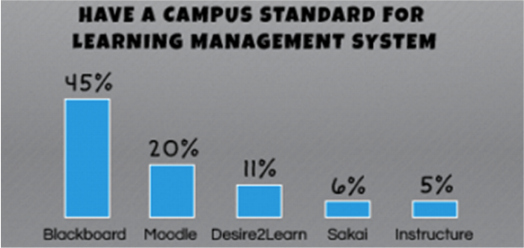
http://www.insidehighered.com/news/2012/11/07/tech-officials-weigh-big-data-moocs-and-open-source

Slide 14
Summary
Past: Sakai was essential to the past decade of progress in open standards for teaching and learning
Present: Sakai 2.9 has excellent support for IMS LTI and IMS CC out of the box
Future: We are in a great position to continue to lead the industry forward in the areas of portability and interopability

